Slide 1
Sentiment Analysis on Twitter (X): Unveiling Digital Emotions
Presented by: Diksha Gole (BSC23DS46)
Course: B.Sc Data Science – Minor Project

Slide 2
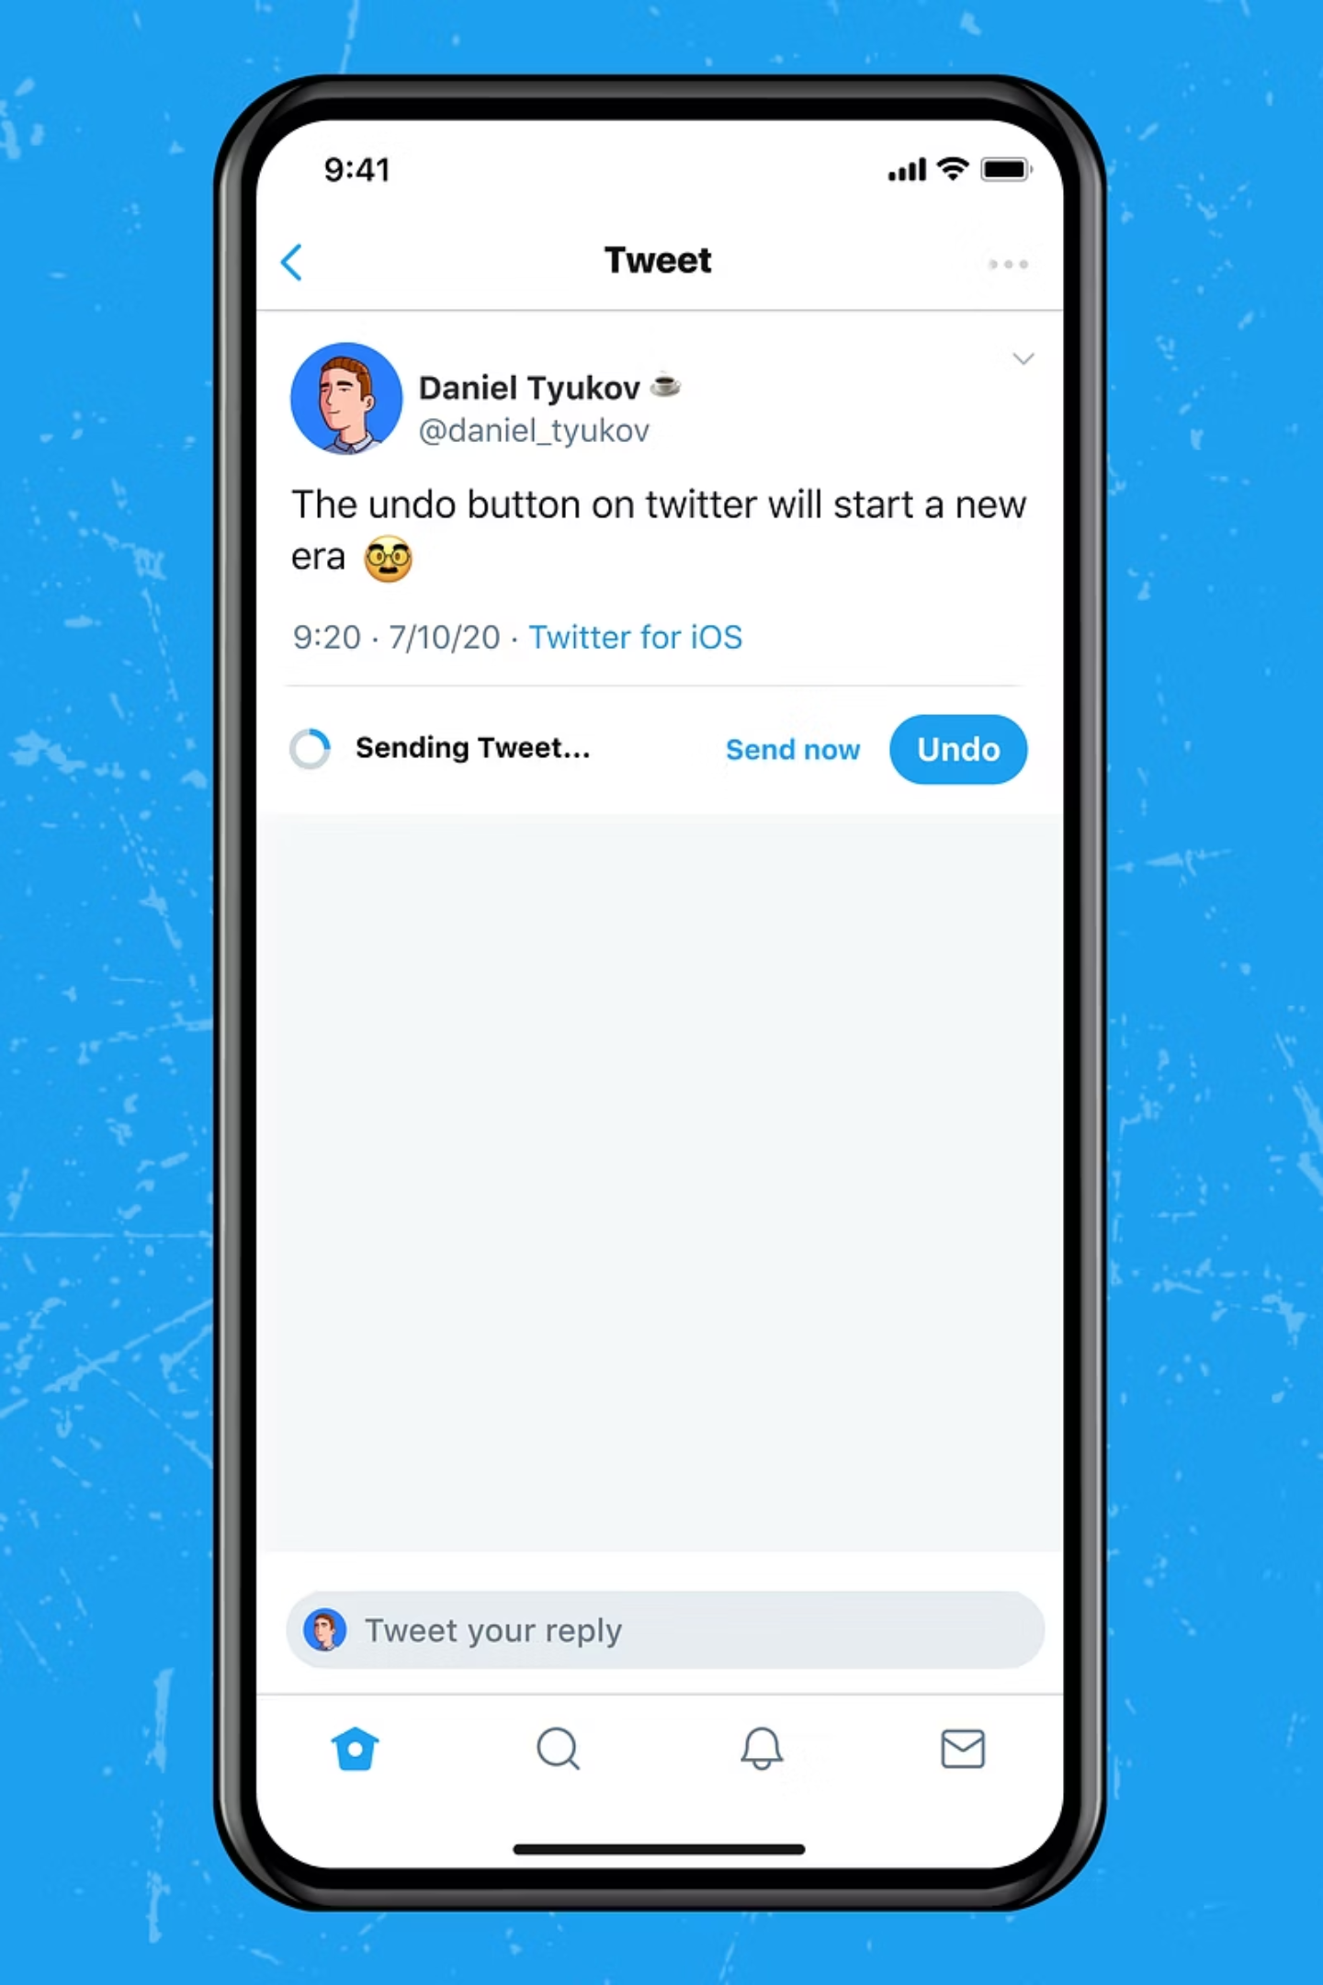
The Challenge: Decoding Opinions on Twitter (X)
Twitter (now X) is a dynamic platform, a real-time repository of millions of opinions. Accurately understanding whether a tweet expresses a positive, negative, or neutral sentiment is crucial for businesses, brands, and researchers alike.
The primary challenge lies in the short, noisy, and informal nature of the language, coupled with the context-sensitive nuances of human emotion.

Slide 3





Our Project Objectives
High-Quality Classifier
Leverage Transformer Embeddings
Integrate Lexicon Features
Develop a robust sentiment classifier using a reliable, research-grade dataset.
Enhance performance with VADER (Valence Aware Dictionary and Sentiment Reasoner) for lexicon-based sentiment analysis.
Implement state-of-the-art Sentence-BERT (SBERT) embeddings to capture deep semantic context.
Efficient Multi-Class Prediction
Evaluate & Deploy
Train a LightGBM classifier, known for its speed and accuracy, for effective multi-class sentiment prediction.
Rigorously evaluate model performance on unseen test data and build a user-friendly Streamlit web application.

Slide 4
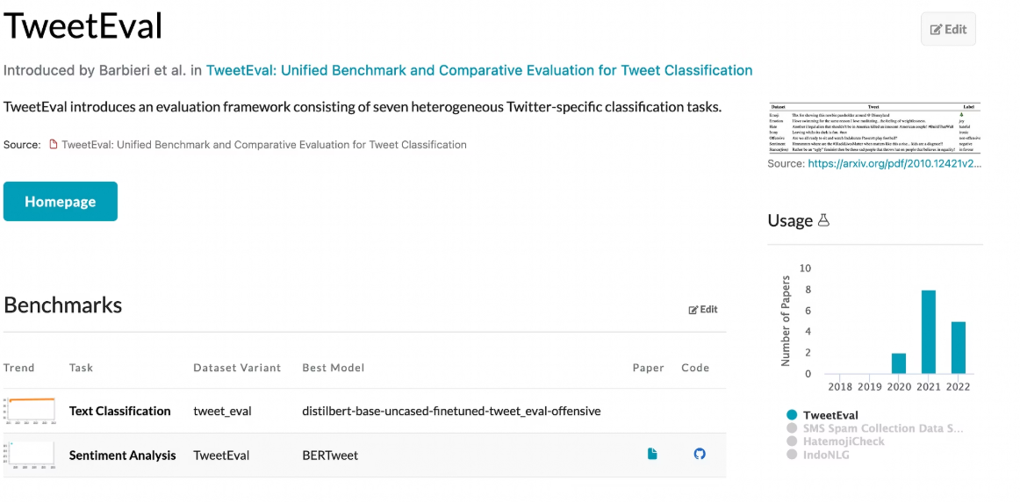
Dataset Snapshot: TweetEval – Sentiment Subset
Our project utilises the TweetEval – Sentiment Subset, a widely recognised benchmark in sentiment analysis research, ensuring robust training and evaluation.
Total Samples:
Train: 45,562
Validation: 2,000
Test: 12,278
Sentiment Classes:
Negative (0)Neutral (1)Positive (2)
This dataset is characterised by its clean, standardised, and balanced nature, providing a solid foundation for model training.

Slide 5

Preprocessing: Preparing Tweets for Analysis
Rigorous preprocessing is vital to transform raw, noisy tweet data into a clean, model-ready format, ensuring optimal performance.
Text Normalisation
Lowercasing all text and standardising variations to maintain consistency.
Noise Reduction
Systematic removal of links, special characters, and extraneous spacing.
Tokenisation & Lemmatisation
Breaking text into individual words (tokens) and reducing them to their base forms to reduce vocabulary size.
Stopword Removal
Eliminating common words (e.g., 'the', 'a', 'is') that add little semantic value.
VADER Integration
Appending VADER sentiment scores to each tweet for enhanced sentiment representation.
Final clean datasets are saved as: clean_train.csv, clean_valid.csv, and clean_test.csv.

Slide 6






Model Architecture: A Hybrid Approach
Our sentiment analysis model leverages a powerful combination of state-of-the-art techniques for superior accuracy and contextual understanding.
VADER (Valence Aware Dictionary)
Provides an additional compound sentiment score, particularly beneficial for tweets rich in emojis, slang, or nuanced language.
SBERT (Sentence-BERT)
Converts each tweet into a 384-dimensional dense embedding, effectively capturing its full semantic meaning and context.
LightGBM Classifier
A fast and efficient gradient boosting model, exceptionally well-suited for handling tabular and numeric data, forming our final prediction layer.
The final input features for the LightGBM model are a concatenation of the SBERT embedding and the VADER sentiment score, creating a rich feature set.

Slide 7






System Workflow: From Data to Prediction
SBERT Embeddings
VADER Scores
Combine Features
Load Data
Clean Data
This streamlined pipeline ensures efficient processing and accurate sentiment prediction, from data loading to real-time demonstration.

Slide 8
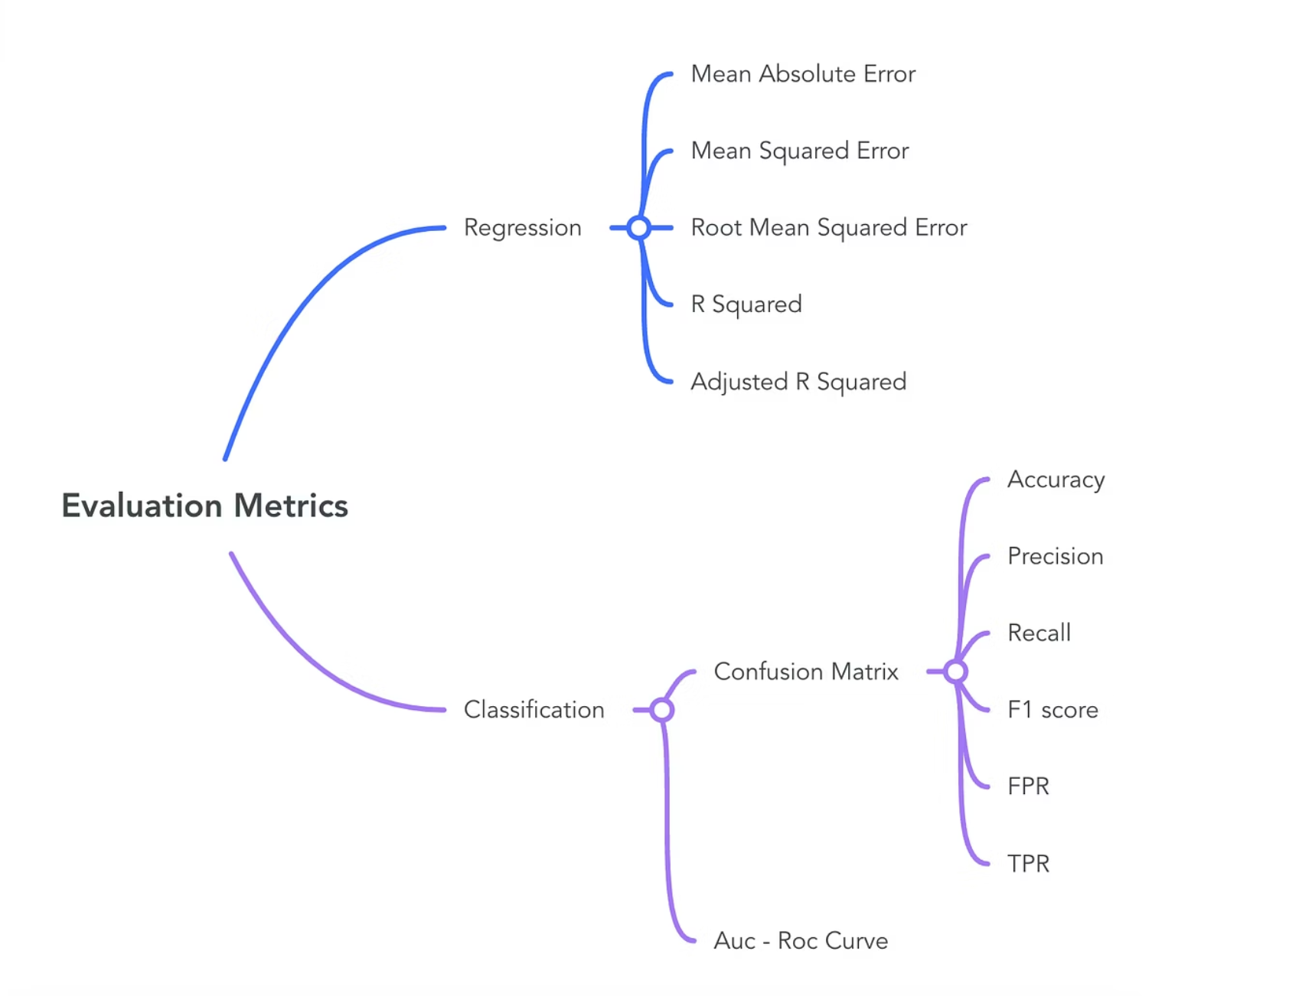
Model Performance: Insights and Challenges
Accuracy Metrics
Validation Accuracy: ~67.65%
Test Accuracy: ~65.66%
Model Strengths
Exceptional handling of contextual nuances in short texts.
Highly robust against noisy and informal Twitter language.
Offers a faster and lighter solution compared to full transformer fine-tuning, making it efficient.
Model Challenges
Struggles with highly ambiguous short tweets where context is minimal.
Sarcasm detection remains a significant hurdle, often requiring more advanced understanding.

Slide 9
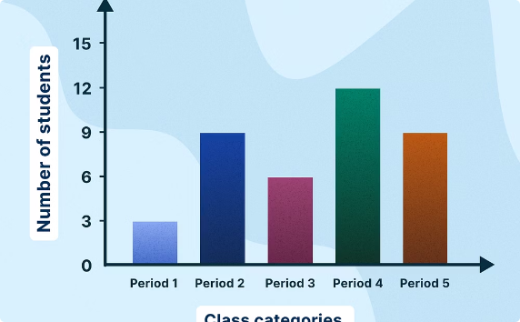
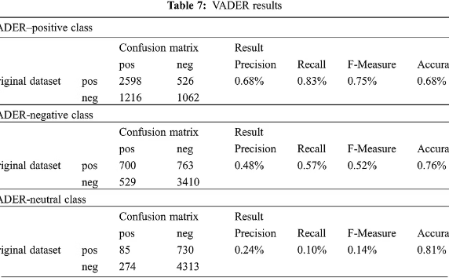
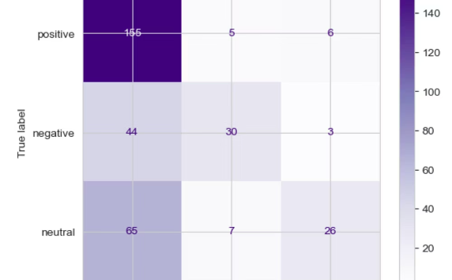
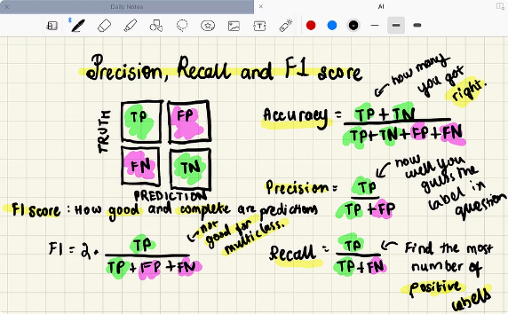
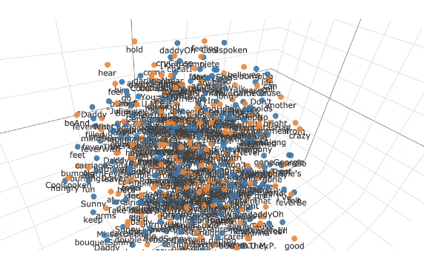
Visualising Sentiment: Key Data Insights
To better understand our model's performance and the underlying data, several visualisations are essential.
Class Distribution
VADER Score Distribution
Confusion Matrix
Precision-Recall-F1 Bar Chart
A bar chart illustrating the balance and frequency of Negative, Neutral, and Positive classes.
A histogram showing the spread of VADER sentiment scores across the dataset.
A visual representation of true positives, false positives, true negatives, and false negatives on the test set.
Comparing the precision, recall, and F1-scores for each sentiment class.
t-SNE Visualisation
A 2D projection of SBERT embeddings, revealing clusters of similar tweets.

Slide 10
Streamlit Application: Real-time Sentiment Demo
Our interactive Streamlit web application provides an intuitive interface for real-time sentiment prediction.
Users can enter any sentence or tweet.
The system instantly predicts the sentiment label (Positive, Negative, Neutral).
Displays a confidence score for the prediction, indicating certainty.
Shows the underlying VADER score, offering additional insight.
Includes an optional history of previous predictions for easy tracking.
This demo highlights the practical utility and responsiveness of our sentiment analysis system.

Slide 11
